Slide 1
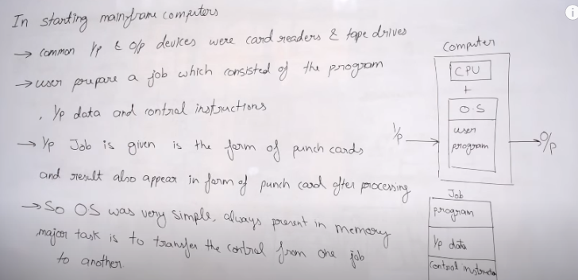

Starting of Operating System

Slide 2
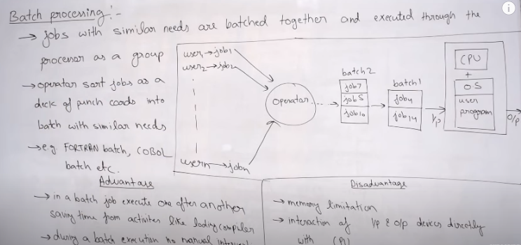
Batch Processing

Slide 3
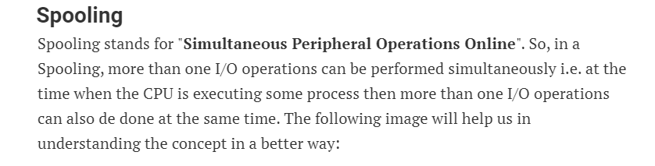
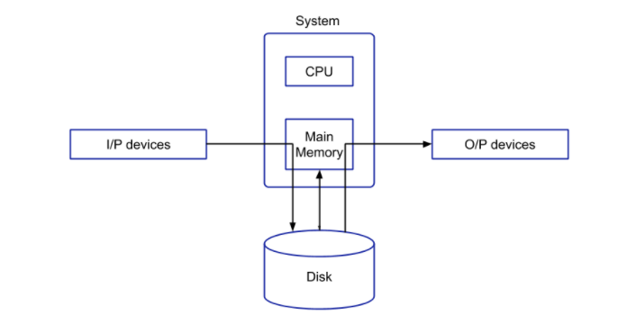
Spooling

Slide 4
Spooling
From the above image, we can see that the input data is stored in some kind of secondary device and this data is then fetched by the main memory. The benefit of this approach is that, in general, the CPU works on the data stored in the main memory. Since we can have a number of input devices at a time, so all these input devices can put the data into the disk or secondary memory. Then, the main memory will fetch the data one by one from the secondary memory and the CPU will execute some instruction on that data. Both the main memory and secondary memory are digital in nature, so taking data from the main to secondary is very fast. Also, when the CPU is executing some task then at that time, the input devices need not wait for its turn. They can directly put their data in the secondary memory without waiting for its turn. By doing so, the CPU will be in the execution phase most of the time. So, the CPU will not be idle in this case.
When the CPU generates some output, then that output is first stored in the main memory and the main memory transfers that output to the secondary memory and from the secondary memory, the output will be provided to some output devices. By doing so, again we are saving time because now the CPU doesn't have to wait for the output device to show the output and this, in turn, increases the overall execution speed of the system. The CPU will not be held idle in this case.
For example, in a printer spooling, there can be more than one documents that need to be printed. So, the documents can be stored into the spool and the printer can fetch that documents and print the document one by one.
Advantages of Spooling
Since there is no interaction of I/O devices with CPU, so the CPU need not wait for the I/O operation to take place. The I/O operations take a large amount of time.
The CPU is kept busy most of the time and hence it is not in the idle state which is good to have a situation.
More than one I/O devices can work simultaneously.

Slide 5
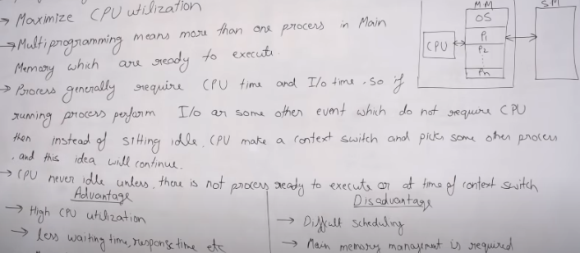
Multi-Programming OS

Slide 6
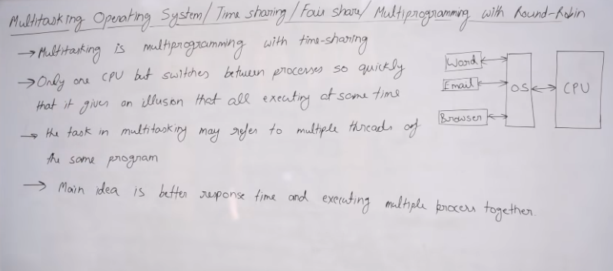
Multitasking OS

Slide 7
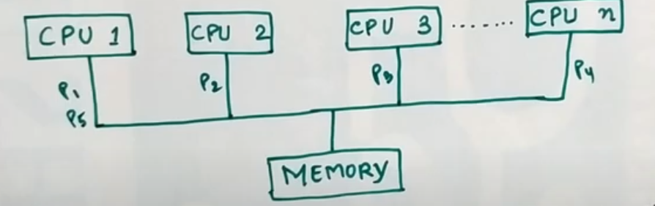
Multi-processing OS
Two or more processors with in a single computer in close communication sharing the system bus memory and input output devices. Different process may run of different CPU as parallel.

Slide 8
Multi-processing OS
Symmetric multiprocessor :- One Os control all the CPU,Each CPU has equal rights. All the CPU are in Peer to Peer relationship.
Asymmetric multiprocessor:- There is a master slave architecture that gives instruction to all the other processors.

Slide 9
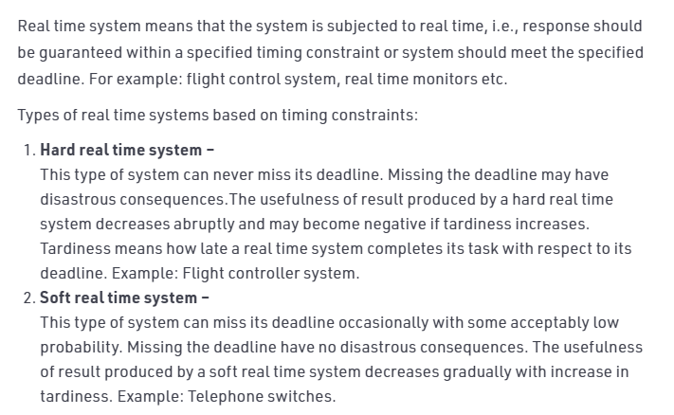
Real time operating system

Slide 10
Distributed OS
A DOS is a system which contains multiple components located on different machines, which coordinate and communicate actions in order to appear as a single coherent working system to the user.
A distributed operating system (DOS), are systems which model where distributed applications are running on multiple computers, linked by communications.
Processors in a DOS communicate with each other through various communication lines like high-speed buses.
All software and hardware compounds are located remotely. In order for them to communicate with each other, they pass messages.
One of the most important aspects of a distributed system is resource sharing. Resources are managed by servers and clients use these resources.

Slide 11
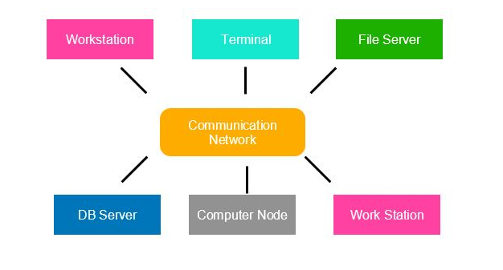
Distributed OS

Slide 12
Distributed OS
There are four main types of distributed systems:
Client-server:
This type of system requires the client to request a resource, and then the server provides that resource which was requested. When a client is in contact with one server, the server itself may serve multiple clients at the same time.
Both the server and the client will communicate over a computer network, which is part of a distributed system.
Three-tier:
The information about the client is stored in the middle tier, instead of storing it in the client, this is done to simplify development. This architecture is most common in web applications.
n-tier:
n-tier systems are used when the server or application needs to forward requests to additional enterprise services on the network.
In 3 Tier Application there are three tiers like Presentation Layer , Application Layer and Data layer. Here the application layer contains business logic as well . On the other hand in N Tier Application layer is divided into 2 i.e. Application Layer and Business Logic layer.
Peer-to-peer:
This type of system contains nodes that are equal participants in data sharing, furthermore, all the tasks are equally divided between all the nodes. These nodes will interact with each other as required as “share resources”. To accomplish this, a network is needed.

Slide 13
Distributed OS
Common characteristics:-
Heterogeneity: In distributed systems, the components can have differences and variety in programming languages, operating systems, computer hardware, networks, and implementations by different developers.
Resource sharing:-(Every resource has its own management policies and methods, furthermore every resource is managed by a module, commonly known as a resource manager)
Resource sharing is the ability to use hardware, software, or data anywhere in the system. The resource manager controls access, moreover, it also provides naming scheme and controls concurrency in the DOS.
Openness:-With DOS, the “openness” is related to the extensions and improvements of disturbed systems. A well-defined and detailed interface of the components must be published. The new component, which is to be added, must be easily integrated with existing components.
Concurrency: This characteristic of the system enables multiple activities in the system to be executed in the same time. In the distributed system, the simultaneous execution of tasks happens in different components running on multiple machines, furthermore, these tasks could execute interactions between each other.

Slide 14
Clustered OS
A clustered OS is a number of computers that share a common file system as equals. The idea is that any computer can crash and the rest of the computers in the cluster can take over. This is different than merely sharing files, because in that case if the computer that is hosting the files die, the files are no longer available.

Slide 15
Types of Clustered Systems
There are primarily two types of clustered systems i.e. asymmetric clustering system and symmetric clustering system. Details about these are given as follows −
Asymmetric Clustering System:-In this system, one of the nodes in the clustered system is in hot standby mode and all the others run the required applications. The hot standby mode is a failsafe in which a hot standby node is part of the system . The hot standby node continuously monitors the server and if it fails, the hot standby node takes its place.
Symmetric Clustering System:-In symmetric clustering system two or more nodes all run applications as well as monitor each other. This is more efficient than asymmetric system as it uses all the hardware and doesn't keep a node merely as a hot standby.

